Slide 1

How to turn Ecosystem payments for Baltic MUSSELS FARMS into a REALITY?
Angela Schultz-Zehden,
SUBMARINER Network for Blue Growth
Malmö, 24 April 2019

Slide 2
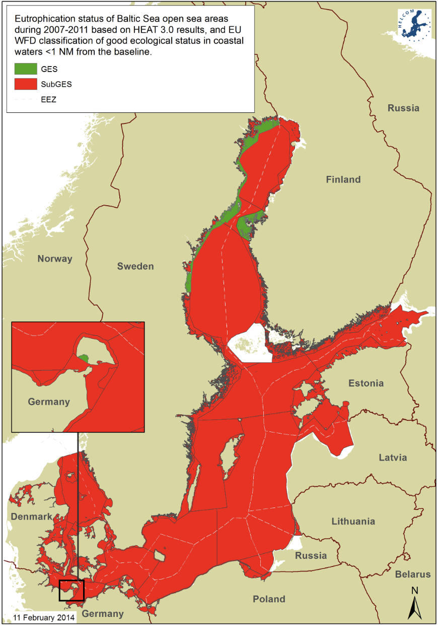
Eutrophication in the Baltic Sea
Additional measures needed !
Not only land-based but
dealing with nutrient content
Figure 1: Eutrophication status in 2007-2011 was assessed as affected by eutrophication (red colour, status less than good; sub-GES) in all the open Baltic Sea sub-basins (HELCOM, 2014).

Slide 3

Mussel farming –
an ecosystem service provider
Food
Feed
Economy (tourism, rural regeneration)
Improve water quality – take up nutrients
Notes:
Mussels provide many ecosystem services – the 4 main being….
Increase water quality – scientifically proven to increase water transparency, thereby increase biodiversity on the seabed. Feeds on phytoplankton, zoopolankton and bacteria and so reduces P / N content in the water body locally.

Slide 4
Mussel farming –
related payments
= €
Food
Feed = ?
Economy (tourism, rural regeneration)
Increase water quality – take up nutrients
Notes:
Mussels provide many ecosystem services – the 4 main being….
Increase water quality – scientifically proven to increase water transparency, thereby increase biodiversity on the seabed. Feeds on photoplankton and so reduces P / N content in the water body locally.

Slide 5
Mussels – related payments
Food = €
Feed = ?
Take up nutrients: as compensation for fish farm (IMTA)
In such case paid by fish farm !
Economy (e.g. tourism, rural regeneration)
Notes:
Mussels provide many ecosystem services – the 4 main being….
Increase water quality – scientifically proven to increase water transparency, thereby increase biodiversity on the seabed. Feeds on photoplankton and so reduces P / N content in the water body locally.

Slide 6
Aim of ES study:
Provide arguments / recommendations for policy makers & mussel farmers
Legislative Framework – a push ?
Who should/could pay for ecosystem services ?
How much to pay ?
How to pay ?
Who needs to do / pay for what ?
Notes:
Compensation study - 3 chapters, aim to give recommendations to first and foremost policymakers on local, regional and national level, extending into EU-level.
What payment schemes secures long-term funding with minimal bureaucracy but also minimises risk for free-riding.
Today (very) quickly going to look at what are the possibilities to get a paid for the ecosystem services mussel farming will provide.

Slide 7
Payment scheme design
What are requirements for a scheme to gain acceptance?
Mussel farmers
On-going / certain security
Policy-Makers
Feasible implementation
Environmental conservationists
Without negative impacts
Effective nutrient removal where desired
Cost-effective measure or cost-effective mix
Legal justification
Addressing uncertainties
Not weakening any other efforts to reach GES and other targets (e.g. nutrient inflow)
Sufficient
Fair and comparable to other funding programmes
Available as soon as possible
Notes:
Starting from the right (policy makers)…legal frameworks
A collection of requirements for each of the target group – illustrates how diffcult it is to come up with a scheme that covers all the different requirement from various stakeholders
Legal justification – in line with MFSD / WFD

Slide 8
Legislative Framework
International Conventions
  UNCLOS, Convention of Biological Diversity, SDGs
  International Convention for Prevention of Pollution from Ships (MARPOL)
EU Legislation
  Water Framework Directive
  Marine Strategy Framework Directive
  Nitrates Directive
  Organic aquaculture according to EU certification
HELCOM Baltic Sea Action Plan

Slide 9

Conclusion
No law forbids mussel farming – but no explicit support
Legal basis for land-based measures for reducing nutrient inflow are in place – weaker for non-point (e.g. agriculture) than point source (e.g. wastewater)
Legislation and policy gap concerning sea-based measures (mussel and seaweed cultivation etc.) reducing nutrient content
Could be used as ‘measure’ under WFD and MFSD – justification for funding
A lot left to national and regional interpretation
Air (ships)
Agriculture
(crops, animals)
Wastewater
Nutrient content

Slide 10
Cost for mussel farming
Costs (EUR) | St. Anna (SE) | Byxelkrok (SE) | Musholm (DK) | Kiel (DE) | Pavilosta (SE) | Västervik (SE) | Hagby (SE) | Åland (FI)
Investment & Establishment | 156,873 | 145,638 |  | 20,000 | 112,000 | 37,037 | 58,536 | 89,817
* per 100 m farm unit | 6,536 | 12,137 | 13,403 | 6,667 | 44,800 | 15,447 | 12,725 | 19,525
Operational costs per year | 7,119 |  |  | 7,441 |  | 5,256 | 8,612 | 14,467
* per 100 m farm unit | 297 |  |  | 2,480 |  | 1,143 | 1,872 | 3,145
Harvest (kg) per year | 39,341 |  | 12,500 | 5,000 |  | 5,250 | 4,635 | 7,200
* per 100 m farm unit | 1,639 |  | 3,125 | 1,667 |  | 2,188 | 1,008 | 1,565
Operational cost EUR per kg mussel | 0,18 | N/A | N/A | 1,49 | N/A | 1,00 | 1,86 | 2,39
The data has been collected by interview of the farm responsibles Mats Emilsson, Tim Staufenberger and Susanna Minnhagen and the managers of associated farms, Mikael Wennström from Åland Government and Gun Lindberg from Västervik municipality.

Slide 11
Comparative measures
Measure | Cost (€/kg reduced N)
Catch Crops | 0,3 - 41,6
Intercrops | 7,5 – 13,7
Reduced fertilization | 15,7 – 27,1
Buffer zones | 9,9 – 34,9
Set aside farmland | 20 – 69,7
Mussels | 13 - 42
For policymakers / politicians to accept mussel farming important that mussel-farming has a place in a “cost-effective” mix of measures
Although costs vary significantly across the Baltic Sea (both sea and land-based), mussels are in the mid-range of measures
Notes:
Danish study made in 2014
Doesn’t take into account that in some areas (like Kalmar municipality) many of the land-based measures are not possible due to lack of land – price goes up even more
Crucial for a scheme to be accepted by politicians / policy makers if public money were to pay for it.

Slide 12
Other sea-based measures
Measure | Cost (€/kg reduced P)
Artifical oxygenation of bottom sediments | 2 - 75
Absorption on fine-particulate marl | 3
Anoxic bottom treatment with aluminium | 50 - 275
Reducing the amount of plankton eating fish | No estimates
Harvesting and cultivation of algae | 60
Mussels | 450
In long run possibly other options
All in experimental phase; negative impacts not fully studied yet
Notes:
Danish study made in 2014
Doesn’t take into account that in some areas (like Kalmar municipality) many of the land-based measures are not possible due to lack of land – price goes up even more
Crucial for a scheme to be accepted by politicians / policy makers if public money were to pay for it.

Slide 13
Financial Sources for Ecosystem Services – Who should / could pay?
Public Funding Programmes
Polluters Pays Principle
Beneficiaries
Malmö 24/04/2019

Slide 14
Payment for ecosystem services (PES)
“One benefactor paying at least an ecosystem service provider for the provision of the service, and there is needs to be an outcome“
(Wunder 2005)
Notes:
We are defining what we are talking about first and we are also classifying the schemes we are describing
-> Problems with the classification, there are countless definitions of Market-based instruments, public and private schemes and of course the most famous term „Payments for Ecosystem Services (PES)“
A Payment for Environmental Services (PES) scheme is:
A voluntary transaction where
a well-defined ES (or a land-use likely to secure that service)
is being ‘bought’ by a (minimum one) ES buyer
from a (minimum one) ES provider
if and only if the ES provider secures ES provision
Outcome meaning – there has to be a proven reduction of eutrophication – either through clearer water or you have a set nutrient uptake per kilo harvested mussels. The compensation is however, not for the activity of mussel farming.
Payment for mussel farming fulfils the criteria!!
The only thing is whether it will be a completely voluntary transaction in benefactor pays schemes – will see later in the recommendations

Slide 15
Public Funding:
European Maritime and Fisheries Fund (EMFF)
  2014-2020
  Sustainable Aquaculture Development – a main priority
  Support aquaculture which provides special environmental services
  Equipment, management & advisory services, training of new farmers & converting to eco-management schemes
  Site selection plans ?
  Mussel farming eligible
  Not ongoing, but important for start up

Slide 16
Public Funding:
Natural Capital Financing Facility
Who?
  Payment of ecosystem services
  Green infrastructure projects
  Pro-biodiversity and pro-adaptation businesses
How?
  Direct &indirect loans
  Technical assistance
How much?
  125 million EUR for 12 projects in Europe (2014-2017-2021)
=> Focus on larger projects; but
larger blue catch crop initiatives in future ?

Slide 17
Public Funding:
European Agricultural Fund for Rural Development (EAFRD)
  Payments to farmers, who voluntarily subscribe to environmental commitments
  22% of expenditure for rural development (20 billion in 2007-2013)
  Payments cover additional costs or
  forgone income when establishing e.g. wetlands
  Payments by EU Member States
  No link to Water Framework Directive

Slide 18
Public Funding:
European Agricultural Fund for Rural Development (EAFRD)
Type of measure | Payment/ support
Catch crops | 110 € / hectare
Spring preparation | 60 € / hectare
Cultivating / building embankments | 50 € / hectare
Protection zones | 300 € / hectare
Taking care of wetlands / dams | 400 € / hectare
Payments for environmentally friendly actions –
NOT only for waiving poluting actions!
=> similar to payments to mussel farms

Slide 19
Public Funding:
European Regional Development Fund (ERDF)
= €
Food
Feed = ?
Economy: Tourism, rural regeneration
Increase water quality – take up nutrients
Notes:
Mussels provide many ecosystem services – the 4 main being….
Increase water quality – scientifically proven to increase water transparency, thereby increase biodiversity on the seabed. Feeds on photoplankton and so reduces P / N content in the water body locally.

Slide 20
Polluter pays principle
Internalizing environmental externalities
  environmental costs are reflected
  in the price and outputs of goods & services
Polluters should take measures
  ➔measure pollution
  ➔ pay taxes or charges for pollution and
  ➔ compensate pollution impacts
Sweden: farmers pay environmental tax when using fertilizers

Slide 21
Polluter pays principle
Problems:
  Not easy to identify all sources and all polluters – not fair
  Difficult to implement from political point of view
  Danger of polluters NOT changing their behaviour –
  but instead ‚buying themselves free from obligations
  Not in line with idea of mussel farming being an ADDITIONAL measure
  Payment of Municipal Wastewater Treatment Plant
  to include mussel farming declined in Swedish court
  Nutrient Trading also failed

Slide 22
Beneficiaries Paying
Philantrophic – private foundations
  John Nurminen Foundation, VELUX Foundation, Zennström philantrophies ....
  Campaigns: ‚adopt a mussel‘ & ‚oysters for life‘
Crowdfunding – e.g. Nutribute Platform
  Connect nutrient abatement projects with voluntary financiers, who are interested in lowering their footprint
Companies
  As part of Corporate Social Responsibility
  Partly co-related to their profile:
  tourism sector / feed industry

Slide 23
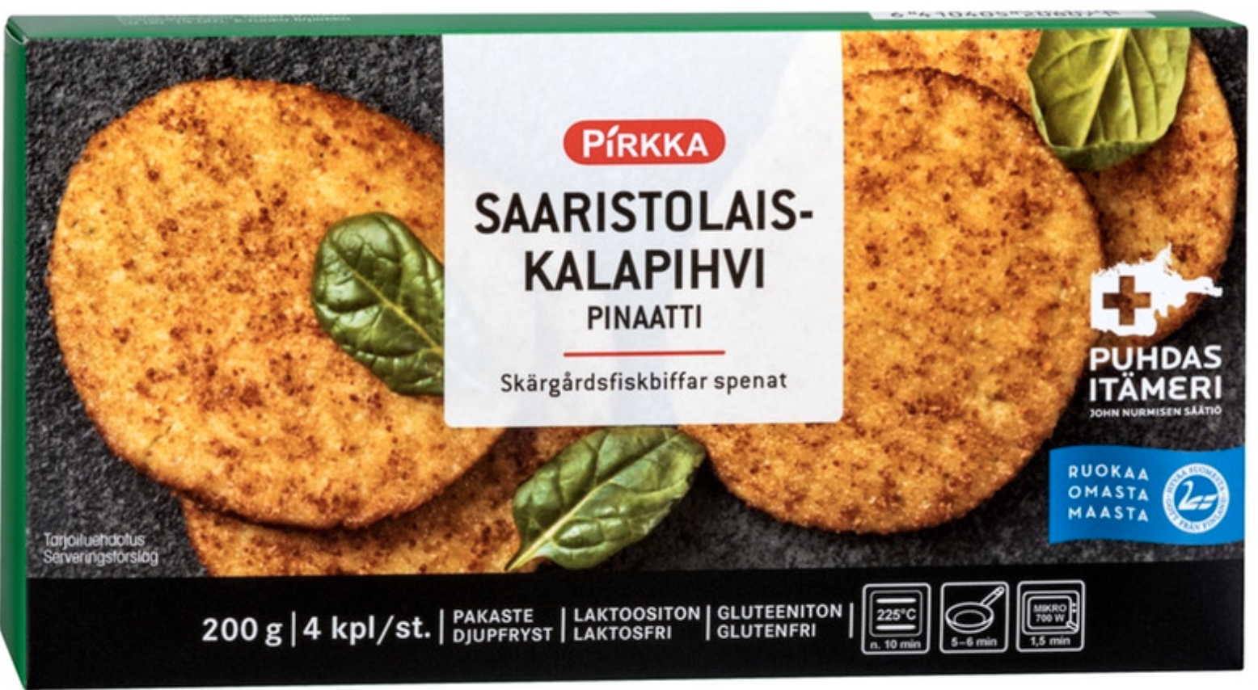
Motivation & willingness to pay
Willingness to pay
  Studies show high willingness to pay
Ecolabelling & certification schemes
  own label for feed produced from mussel meal
  Baltic Sea friendly hotel
Nutrient Emission Calculator
  estimate your nutrient footprint
  reduce emissions
  purchase offsets for emissions you cannot avoid
  use this money into offset projects

Slide 24
Ideas for Payment Schemes
Responsibility – choosing the right policy level
  EU/National vs. Regional/Local
Criteria for Payments
  Reward for providing ecosystem services
  Based on amount of nutrients taken out of sea
Investment vs. Operational Costs
  Support set up of farms & equipment (e.g. EMFF)
  Outcome based payments for mussels harvested
  Further processing to be covered by ‚users‘ of mussels

Slide 25
How to pay for (operational) costs?
General subsidy
  Funding agency determines maximum amount each farmer receives
Scored Subsidy
  Scores for various characteristics such as location or growth rates
  Service provider with best score is offered a payment
Reverse auction with fixed cap
  Sellers of mussels related to ecosystem services ‚bid‘ on a per unit price for e.g. nutrient removal ➔ maximum payable amount determined by the buyer

Slide 26
Way Forward
Acceptance / proof that mussel farming provides ES wanted
  Common standards, monitoring, verification, performance, certification, monitoring
  Public cause !
Importance of right site for right purpose
  Criteria for mussel farm sites may differ according to purpose
  Public bodies interested should develop site plans according to targets
Support for investments, monitoring, training, payment test
  EMFF / NCFF
Voluntary schemes good start for ongoing payment
  Schemes available: now !
  Nevertheless administrative / legislative framework better for continuous schemes to grow and to avoid free-riding
Lobby for the future
  HELCOM Baltic Sea Action Plan
  EADRF: check additionality & influence the future
Notes:
Public intervention makes it easier to organise such a scheme with payments, certification and monitoring.

Slide 27
Finally, some immediate tips for farmers
Private foundations, crowd-funding and similar incentives should not be overlooked – can provide good start-up sum.
Look & lobby for national/regional programmes - that fund a farm
Organise yourselves into associations / cooperatives to share costs and to share experiences on getting funding
Organise ‚proof‘ of nutrient uptake
Notes:
Such as the nutribute platform….
In Sweden there is a lot of funding on national level – get in contact with local public authority or HaV to find out more
Cooperatives might have a negative connotation in former soviet states, but forming a network that could serve as an advisory service, to bring in new young entrepreneurs and act as a united voice isn’t necessarily a bad idea.

Slide 28
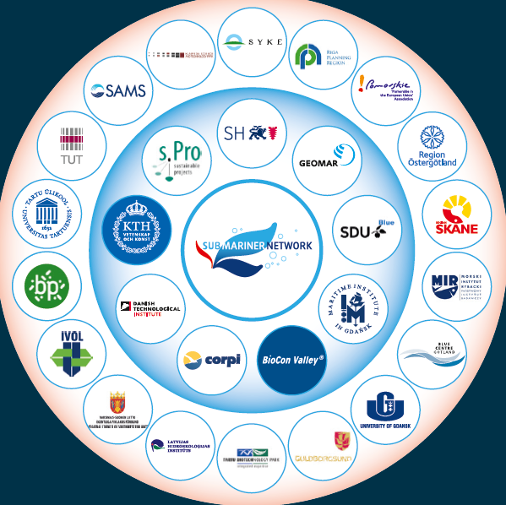



Members of the SUBMARINER Network
Mussel Community Network
the hub
for promoting
a sustainable marine (bio) economy in the Baltic Sea Region and beyond
Member of:
Full members
Flagship of:
Associate members

Slide 29




Thank you for your attention!
Angela Schultz-Zehden,
SUBMARINER Network

